Slide 1
gdax-orderbook-ml: Application of machine learning to GDAX orderbook https://github.com/timothyyu/gdax-orderbook-ml
Timothy Yu
5/23/2018, Rutgers Project Demo Day @ Indiegrove (Jersey City, NJ)
Rutgers Data Science
Revision V0.1b

Slide 2

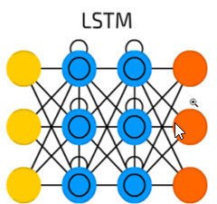
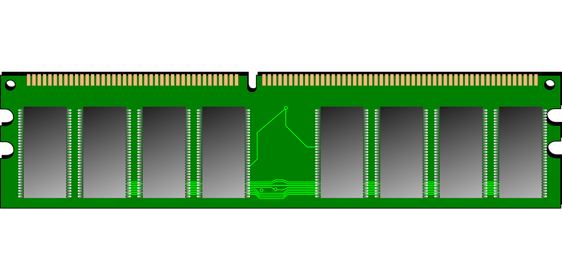
Project Objective
Predict new price support/resistance levels, 15 minute basis
Bitcoin/USD pair
Use orderbook data + 15 minutes of chart data combined
Orderbook: [buy/sell side, order price, order size]
Chart: [open, high, low, close]
Pseudo-semi supervised learning
Stacked LSTM/GRU Model

Slide 3
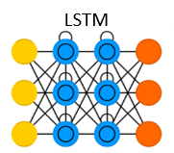
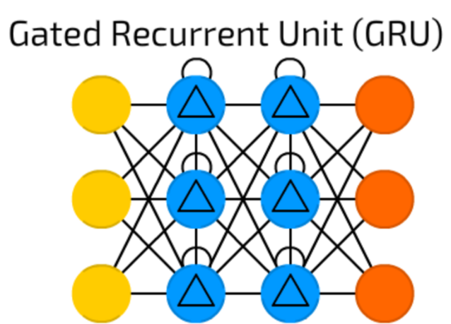
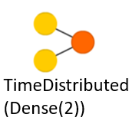
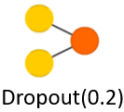
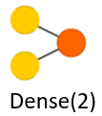

Deep Learning Model Structure
128 Units
32 Units
64 Units
32 Units
2 Units
20% Dropout
2 Units
LSTM for Orderbook Size Dimension
LSTM for Features Breakout from GRUs
LSTM for Price Dimension
32,64,128,256,32 Units
Y value
Stacked GRUs for Features Breakout
1: Likely to be new S/R level
0: Not likely to be new S/R level

Slide 4
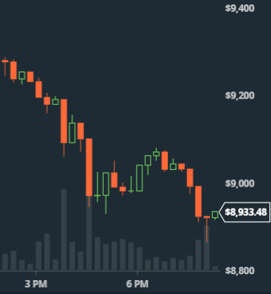
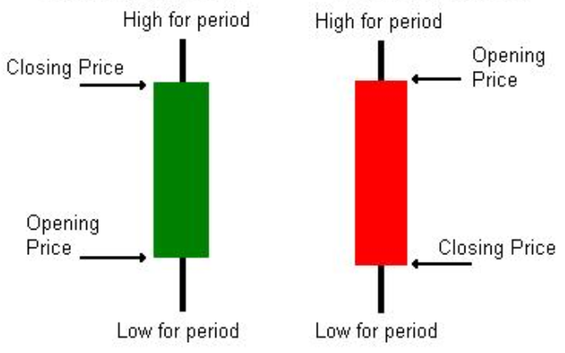
Candlesticks, OHLC Data from API
[open, high, low, close]

Slide 5
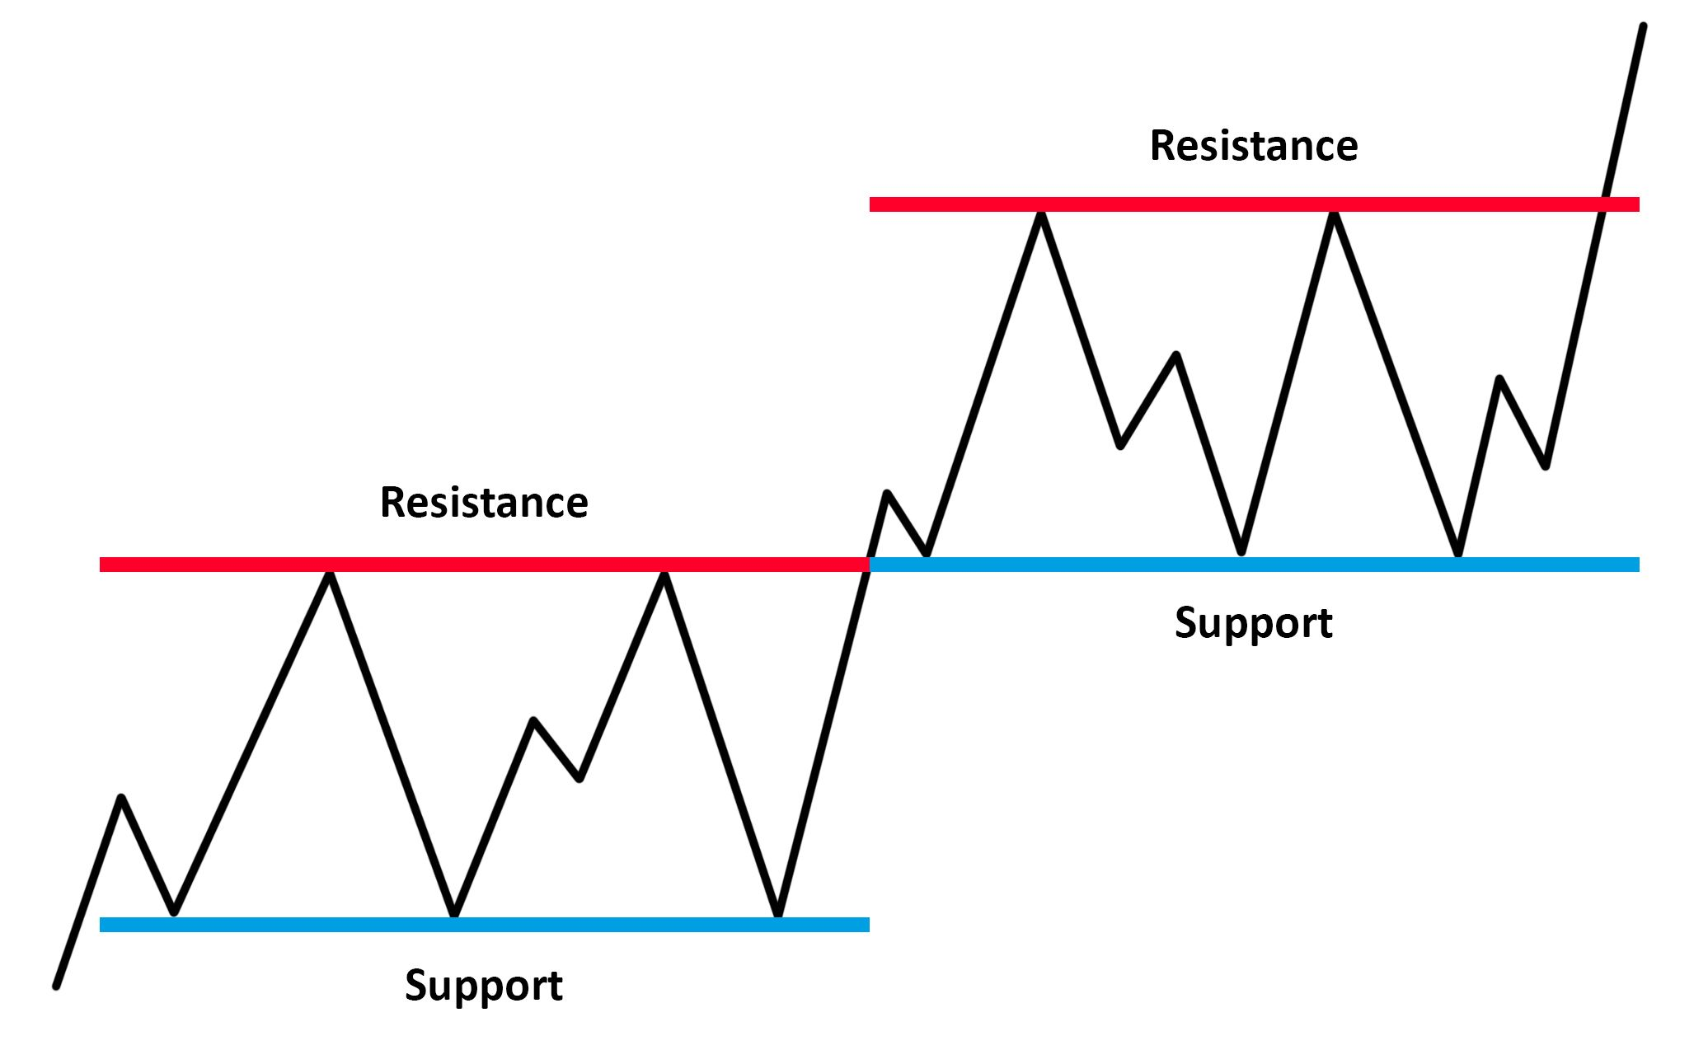
Support and Resistance Explained
$1000
$1000
$700
$700
$500
$500

Slide 6
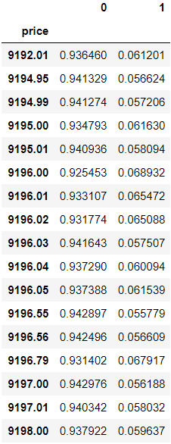
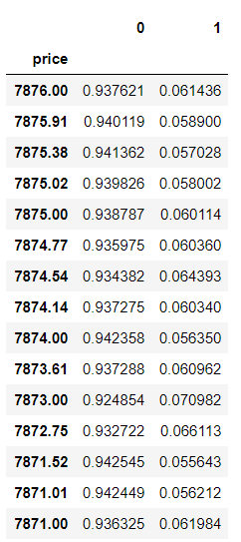
Model Predictions (+/-$1000 range)
Predictions in dollar range +/- 1000 from Min and max support/resistance levels
Results display characteristics of how the orderbook moves in relation to S/R levels

Slide 7
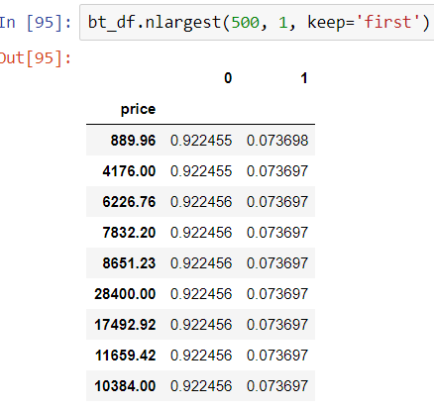

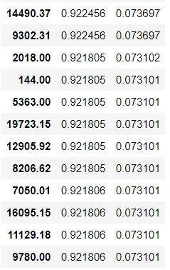
Model Predictions (by largest value)
Sample predictions with outcome values displayed
Potential to cross reference with historical support/resistance levels
Further exploration: grouping the results together for further analysis

Slide 8

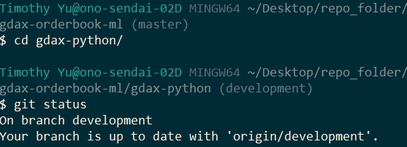
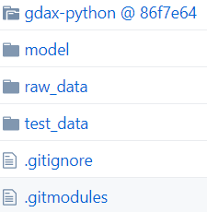
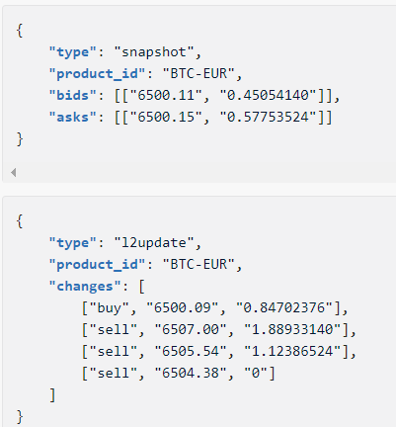
Python API, Git submodule, Websocket JSON
Orderbook “snapshot”:
[price, size]
Updates to snapshot “l2update”:
[side, prize, size]
Scrape_start() and load_parse() to retrieve, parse, and load data

Slide 9
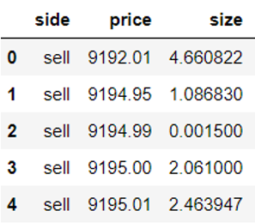

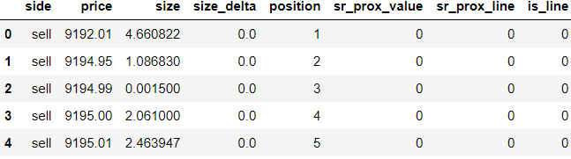
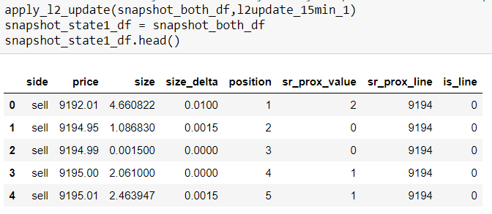
Snapshot
before non-natural features initialized

Slide 10
Issues and Limitations
Issues
Limitations
Train test split doesn’t work on reshaped input/X data
Scaling issues with features for input
Normalization of features that have distinct spatial relationships
Candlestick API request not working as intended/designed
RAM/GPU for model complexity and memory usage
API request for updated 15-minute autogenerated support and resistance doesn’t currently work
Model may be overfitting for 0 outcome instead of 1
Model learning rate and hyperparameters
Storage format for orderbook data size/latency I/O limitations

Slide 11
Model/project restructure and expansion
Relevant Publications
Trade arrival dynamics and quote imbalance in a limit order book
Orderbook modeling
A Continuous-Time Measurement of the Buy-Sell Pressure in a Limit Order Book Market
Deep Learning for Limit Order Books
Machine Learning for Market Microstructure and High Frequency Trading
Model Restructure
Restructuring model using the Keras Functional API or raw TensorFlow (non-sequential)
Parallelizing LSTM/GRU input sequences to fully leverage timestep input dimension/feature
Application of 2D Convolutions to Orderbook Matrix as separate feature
Incorporation of major historical support and resistance as model feature (awareness)
Publications relevant toward model expansion, restructuring, and increasing model precision and feature abstraction/generalization

Slide 12
Publications & whitepapers referenced for model structure and design
How to Construct Deep Recurrent Neural Networks
Training and Analysing Deep Recurrent Neural Networks
Where to Apply Dropout in Recurrent Neural Networks for Handwriting Recognition?
Dropout improves Recurrent Neural Networks for Handwriting Recognition
Speech Recognition with Deep Recurrent Neural Networks
Recurrent Dropout without Memory Loss
Taking concepts from publications and whitepapers, but putting them into practice
Theory --> Application --> Practice

